Slide 1
Introducing INPAS
The First Global Standard for Non-Profit Financial Reporting
Visit www.inprf.org
Notes:
This slide deck introduces the International Non-Profit Accounting Standard, which was published on 20 October 2025 by the International Non-Profit Reporting Foundation. This slide deck and the standard itself are available for free download from www.inprf.org

Slide 2
The Problem
Each year, 10M+ non-profit organisations (NPOs) manage billions of dollars across the globe. NPOs operate in a unique context:
x
Not profit-driven like businesses
x
No public mandates like governments
Face sector-specific challenges: restricted funds, donor demands, broad accountability
Unlike the private and public sectors, until now there has been no international standard for non-profit financial reporting.
Notes:
Over 10 million organisations in the global non-profit sector manage billions of dollars each year.
These organisations operate in a unique space—unlike businesses, they don’t generate profits, and unlike governments, they lack public service mandates.
Despite the sector’s size, scale, and distinct context, there has been no international standard for non-profit financial reporting.

Slide 3
The Impact
In the absence of an international standard:
?
Donors require detailed financial reports, each differing by grant
Regulators in different countries impose inconsistent reporting rules
Non-profits juggle multiple frameworks, struggling to tell a coherent financial story
The Result? A lack of trust and operational inefficiencies that undermine the sector’s ability to focus on what matters most
—its social good mission.
Notes:
In the absence of such a standard, the sector has faced significant challenges:
Donors require detailed and varied financial reports, each differing by grant
Regulators in different countries impose inconsistent reporting rules
Non-profits are left juggling multiple frameworks, struggling to present a clear and cohesive financial story
The result? A lack of trust and operational inefficiencies that undermine the sector’s ability to focus on what matters most—its mission.

Slide 4
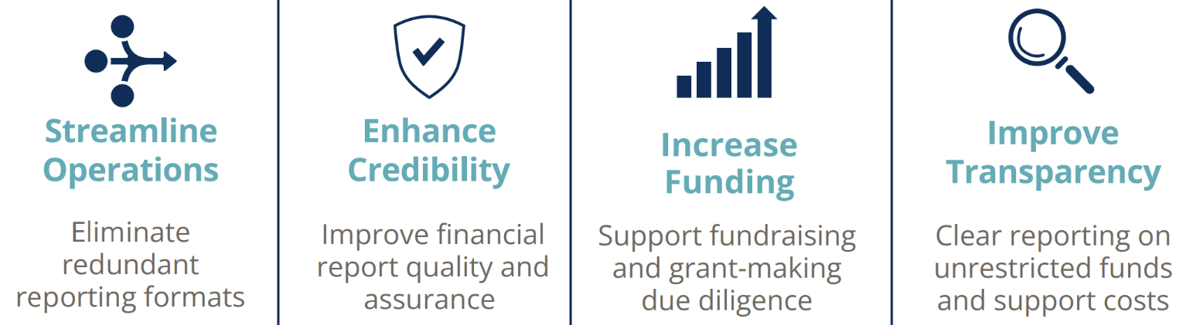
The Solution
International Non-Profit Accounting Standard (INPAS)
The world’s first internationally applicable financial reporting standard designed by non-profits, for non-profits.
By adopting INPAS, the sector will:
Notes:
Regulators and donors can now request financial reports in accordance with INPAS, thereby eliminating multiple similar yet different redundant formats, and streamlining the financial operations of NPOs.
The financial reports and audit opinions will be more reliable and useful, building trust and credibility with all stakeholders.
Consistent financial statements and narrative reports that answer many of the key questions asked by potential donors can make fundraising and due diligence smoother, and improve access to funding, even for smaller or local organisations.
With improved transparency about the nature and level of support costs, fund accounting and the use of unrestricted funds, this smooths the path for better quality of funding and improved financial resilience of NPOs.

Slide 5

Surprising combination!
Improve quality and reliability of financial reports
Reduce burden of multiple formats
Notes:
Usually, increasing quality means increase burden!
But by meeting the needs of donors and regulators, INPAS can reduce the burden on NPOs needing to produce multiple special purpose reports.

Slide 6
A global initiative a decade in the making
Research* Shows Global Demand
72% of CCAB’s respondents (605 from 172 countries) support creation of an international standard
IFR4NPO Launch
Humentum and CIPFA, with funding from Ford Foundation and OSF, launch the International Financial Reporting for Non-Profit Organisations
INPAS Publication
Marking over a decade of engagement and collaboration
2015
2021-24
2014
2019
2025
In principle support but no resources
The International Accounting Standards Board (IASB) recognises the need for a standard but is unable to fund its development
Global Public Consultation
Ongoing outreach and opportunities for input, incorporating diverse stakeholder perspectives
*CCAB study
Notes:
According to research in 2014, global demand for an international standard was particularly noticeable from countries in the ‘Global South’. 72% of respondents from 172 countries supported it.
The International Accounting Standards Board (IASB) acknowledged that a standard was needed, but concluded it was outside its own mandate, and was not able to fund its development.
The IFR4NPO Project (International Financial Reporting for Non-Profit Organisations) was launched in 2019, through a partnership between the Chartered Institute of Certified Public Accountants (CIPFA) and Humentum, both non-profits, and funding from The Ford Foundation and the Open Society Foundations to solve the problem ‘by the sector, for the sector’.
In 2021-2024 the project issued a consultation paper and an Exposure Draft in 3 parts, receiving deep and broad feedback and input from a diverse range of stakeholders and countries.
The International Non Profit Accounting Standard (INPAS) was published on 20 October 2025

Slide 7
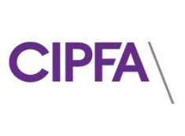


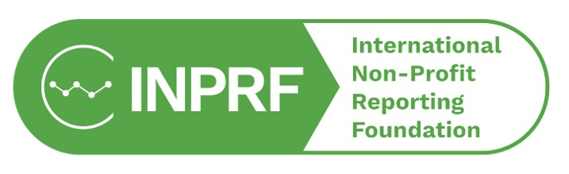
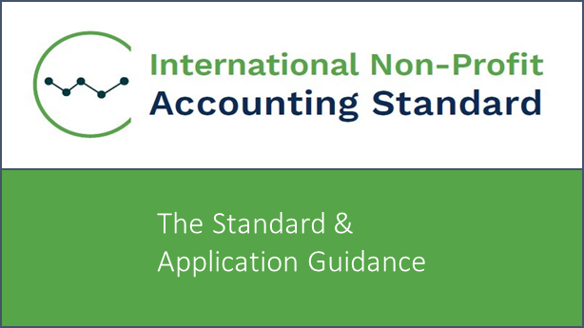
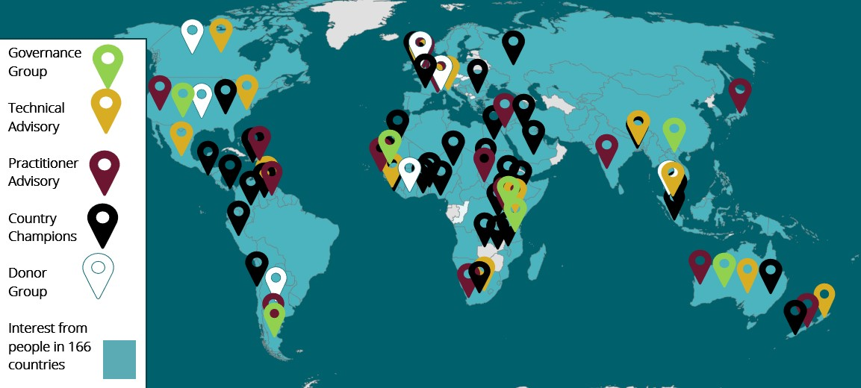
From Project to Legacy
Project partners
Founder members
2019-2025
2025 onwards
The Standard
The Community
15,000+
Newsletter subscribers
+ LinkedIn & YouTube
Notes:
The IFR4NPO Project finished in October 2025, with its key outputs being the INPAS standard itself, and the global community of stakeholders with an interest in non-profit financial reporting.
In September 2025, a new Foundation was created, called the International Non-Profit Reporting Foundation, with the standard and the community being passed on to the Foundation to continue the work.
CIPFA and Humentum were the founding members, with others expected to join.

Slide 8
Completing the suite
IFRS (For-profits)
Name: International Financial Reporting Standards and IFRS for SMEs
IPSAS (Governments)
Name: International Public Sector Accounting Standards
INPAS (Non-Profits)
Name: International Non-Profit Accounting Standard
Since 1973
Since 1997
From October 2025
Issued by: IFRS Foundation – IASB*
Issued by: International Federation of Accountants – IPSASB**
Issued by: International Non-Profit Reporting Foundation
* International Accounting Standards Board
** International Public Sector Accounting Standards Board
Notes:
INPAS now completes the suite of international financial reporting standards, and the International Non-Profit Reporting Foundation is now the world’s third accounting standard setter – dedicated to the needs of the non-profit sector.

Slide 9
INPAS Objectives
Preparers & users
High quality
Transparent
Credible
NPO issues
Comparable
Useful
✓ To improve the quality, transparency and credibility of NPO financial reports.
✓ To support the provision of NPO financial information that is useful for decision making and accountability, balancing the needs of preparers and users.
✓ To address specific NPO issues, which will promote increased comparability of NPO financial reports.
Notes:
[Read the objectives from the slide]

Slide 10

INPAS
What it is: Guidance for nonprofits to prepare complete (whole-of-entity) financial reports, published by International Non Profit Reporting Foundation
Principles-based: A framework for presenting a true and fair view of an NPO’s financial position and performance, based on IFRS for SMEs Accounting Standard.
What it covers: Accruals-based accounting treatments (recognition, measurement, presentation and disclosure) and accompanying narrative reports.
Who adopts: Each country decides if INPAS is required for registered NPOs. Nonprofits may also voluntarily adopt if permitted.
The Standard
Notes:
INPAS is Guidance for non-profits to prepare complete whole of entity financial reports, sometimes called the annual audited accounts.
It is published by the International Non-Profit Reporting Foundation
It is a principles-based framework for presenting a true and fair view, based on the IFRS for Small and Medium Entities Accounting Standard
It covers accrual basis accounting treatments as well as accompanying narrative reports.
Just like IFRS, it is up to countries to adopt it for registered NPOs. Nonprofits may also voluntarily adopt it if permitted to do so.

Slide 11

INPAS and INPAS Guide 1
Approx 300 pages, provides guidance on whole-of-entity financial statements and accounts
Standard and Application Guidance
Individual grant reports link to whole-of-entity finances
Approx 30 pages, provides guidance on grant reports
Practice Guide 1
Harmonised Grant Reporting
Notes:
INPAS and INPAS Practice Guide 1 work together, so that the whole-of-entity financial statements and grant reports can work together,
Information in the whole of entity accounts provides a link to the grant reports, and each grant report must include a reconciliation to the whole of entity accounts. This means a significant improvement in the reliability of grant reports. So it’s a win for NPOs AND funders.

Slide 12

INPAS Guide 1: Harmonised Grant Reporting
What it is: Guidance for nonprofits to prepare individual grant or project reports, which can reconcile to the whole-of-entity financial statements when used alongside INPAS.
Rules-based: Provides harmonised expenditure headings, ensuring consistency across grants.
What it covers: A standard format report of income, expenses and balances, with notes and flexible column headings.
Who adopts: Funders can choose to accept or require grant reports in the ‘INPAS Guide 1’ format. NPOs can also use the expenditure headings for their own budgeting and encourage their funders to accept this format.
Practice Guide 1
Harmonised Grant Reporting
See separate presentation slides here.
Notes:
INPRF has also produced a Practice Guide, hopefully the first of many.
INPAS Practice Guide 1 about harmonized grant reporting
It’s a pragmatic, rules-based approach to grant reporting, bringing consistency, and reducing the burden for grantee organisations, while also including enough flexibility to meet donors needs.
Funders are encouraged to adopt it, and NPOs can use the expenditure headings for their grant budgeting.
For more information about that, see the separate presentation.

Slide 13
Adopting Harmonised Grant Reporting
All NPOs
INPAS
International Non-Profit Accounting Standard
Practice Guide 1
Harmonised Grant Reporting
Greatest benefits when used together
May be used separately
Notes:
INPAS and INPAS Practice Guide 1 are designed to be used together, but either may be used separately.
Donors and grantee NPOs may choose to use INPAS Practice Guide 1 for grant accountability before an NPO has adopted INPAS for its whole of entity financial reporting.
The Harmonised Grant Reporting format may also be used in conjunction with other accounting frameworks.
NPOs may prepare their whole-of-entity financial reports using INPAS, before or without preparing Supplementary Statements or Grant reports in accordance with INPS Practice Guide 1.
To be clear about the different pathways:
Adoption of INPAS is driven by Governments or Regulators with the authority to mandate requirements in their jurisdictions.
Adoption of INPAS Practice Guide1 is driven by grantors and NPOs when agreeing grant accountability requirements

Slide 14
INPAS – the package
The Standard: Authoritative guidance for accounting treatments and financial reporting requirements.
Implementation Guidance: Additional non-authoritative guidance and illustrative examples.
  Illustrative financial statements: Annex to the IG – shows what a set of financial statements could look like.
Basis for conclusions: Explains the rationale for key accounting treatments and financial reporting requirements, summarises the main considerations.
Practice Guide 1: Harmonised Grant reporting
The Standard
Notes:
When you access INPAS, you will find there are 3 volumes.
1. The Standard and application guidance include authoritative guidance that must be followed where INPAS is being followed.
2. The Implementation Guidance includes additional guidance to help NPOs, including illustrative examples and illustrative financial statements. It is non-authoritative
3. The Basis for Conclusions outlines the reasons for various decisions, including where members of the Technical Advisory Group were not in agreement, or areas where further work is recommended. It is available to license holders.
Practice Guide 1 is a separate document.

Slide 15
How was INPAS developed?
Notes:
INPAS is a trusted and credible standard because of the robust process used to develop it.

Slide 16
Financial statement users & needs
 | For-profit | Not-profit
Who? | Investors | Providers of finance Public that benefits
Why? | Investment decisions | Accountability and decision making
What info? | Return on capital Profitability | Meeting purposes Management of resources Capacity to continue Compliance
Notes:
Developing the standard started with thinking about fundamental questions who are the main users of NPO financial statements, and what are their information needs?
It’s not about investors looking at profitability and return on capital.
From the research, we identified two primary user groups: providers of finance, and the those that benefit from the services provided by the NPO.
Given the stewardship role of trustees, and the fiduciary nature of their role, the financial statements are important for accountability, and also for decision making. Those decisions could range from funding, to partnerships or tax status.
The 4 areas of information stakeholders are interested in are:
Is the NPO meeting is stated purposes? What impact is it making?
Is the NPO managing its resources well and properly?
Is the NPO able to continue in operation? How is its financial health?
Is the NPO complying with all relevant laws and requirements?
As the various sections of INPAS were reviewed or developed, these core information needs of users were front of mind.

Slide 17
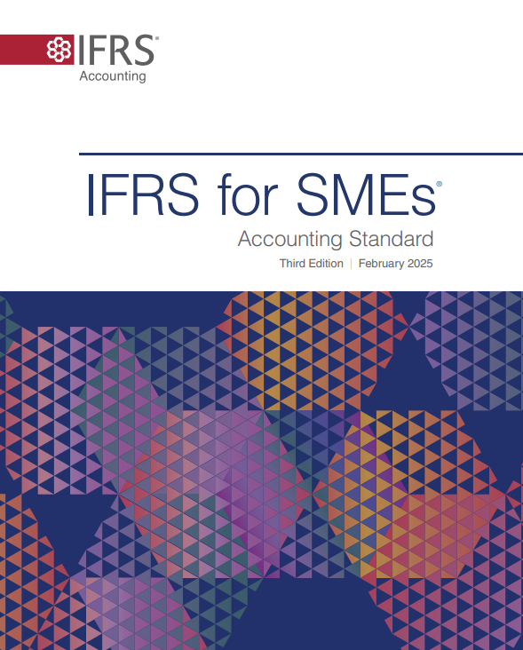
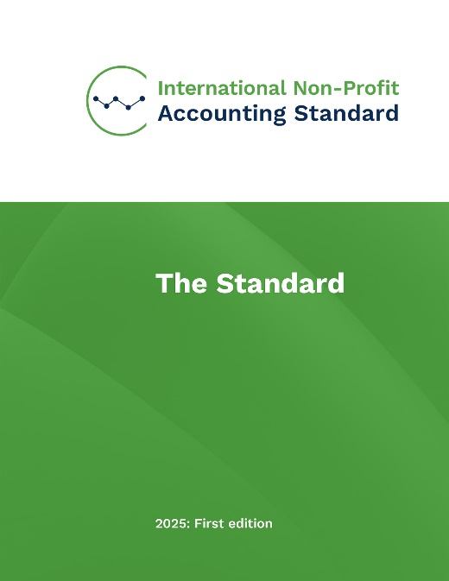
Guidance development model
Section status | Description
Modified | Fully updated to reflect NPO requirements.
Editorial | Updated to align with modified Sections, but not in itself fully reviewed
Unchanged | Updated for terminology changes only
New | Developed specifically for NPOs.
Removed | Not relevant to NPOs
IFRS, IPSAS & National standards
Notes:
INPAS uses the International Financial Reporting Standard for Small and Medium Entities (IFRS for SMEs Accounting Standard) as its base.
This ensures continuity with for-profit accounting where appropriate, and enables consistency across sectors over time, while also addressing unique sector specific needs.
INPAS also draws on guidance in full IFRS, aspects from the International Public Sector Accounting Standards (IPSAS) and national standards.
Two completely new sections were developed – relating to narrative reporting and fund accounting.
In accordance with the priority list identified in the initial 2021 consultation, certain sections were fully reviewed and modified,.
Where relevant, some sections were edited to be consistent with the modified sections
Other sections had minor terminology updates only
The section on earnings-per-share was removed
Finally, the sections were restructured for a coherent all in one document.

Slide 18

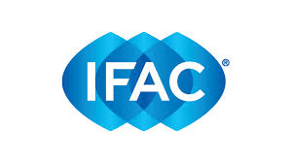
Licensing
The IFRS Foundation granted INPRF a licence to use the IFRS for SMEs Accounting Standard as the basis for INPAS.
IFAC granted INPRF a licence to use IPSAS.
Notes:
INPAS makes use of copyrighted material from IFRS for SMEs and IPSAS, with permission.
INPRF is grateful to the IFRS Foundation and the International Federation of Accountants (IFAC) for their support, and the licenses to use this material.

Slide 19
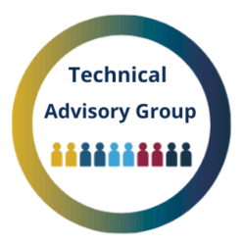

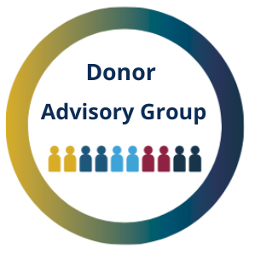

By the sector, for the sector
Input from volunteer advisory and reference groups
  Technical Advisory Group (TAG) – national accounting standard setters from every continent (and IASB as official observers)
  Practitioner Advisory Group (PAG) – NPOs, auditors, consultants, academics
  Donor Advisory Group with bilateral and multi-lateral funders and foundations.
  Engagement supported by 45 volunteer Country Champions
Notes:
INPAS was developed with input from volunteer advisory and reference groups
The Technical Advisory Group comprises national accounting standard setters from 13 countries – including some that had already developed their own nonprofit guidance (eg UK, US and Canada) as well as those with a keen interest in INPAS adoption (eg Kenya & Bangladesh)
The Practitioner Advisory Group consists of NPOs, as well as auditors, consultants and researchers familiar with the real world of preparing, auditing and using NPO financial statements. The interplay between these two groups, each representing a range of diverse viewpoints, was vital for challenging and honing the proposals that were then put to public consultation.
Given that Donors are key users of NPO financial reports, and play a significant role in shaping reporting grant reporting requirements, their input remains essential, and the Donor Advisory Group gave vital input.
45 Country Champions support outreach in their respective contexts, languages and time zones, to ensure strong engagement and robust feedback to the public consultations.

Slide 20





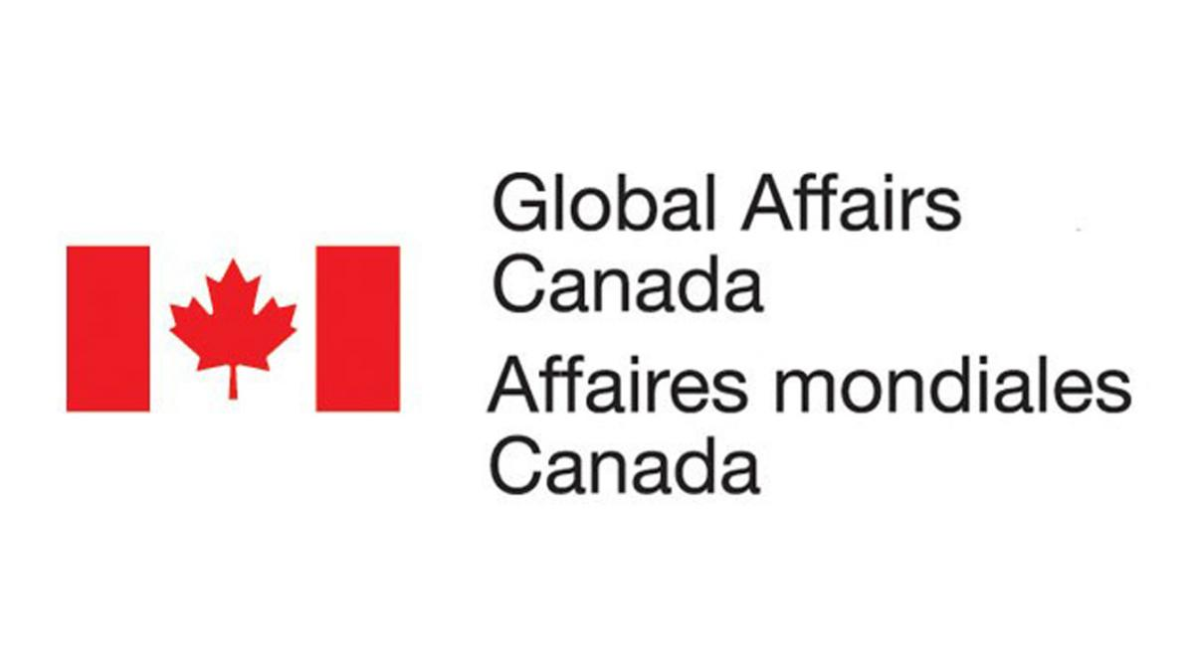






Donor Advisory Group members
Notes:
The members of the Donor Advisory Group include Government agencies including the UK and Canada, multilaterals such as the World Bank, and foundations from Europe, US & Malaysia.

Slide 21
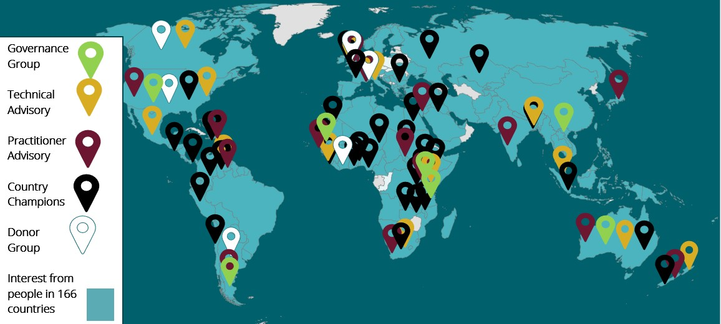
INPAS Development: The Numbers
1 Consultation Paper, 3 Exposure Drafts, 1 Final Standard
$4m funding over 6 years
5,000+ hours of donated professional time.
15,000+ followers from 169 countries.
15,000+
Newsletter subscribers
+ LinkedIn & YouTube
Notes:
The process to develop INPAS involved publishing a consultation paper and three exposure drafts before issuing the final standard.
It cost nearly $4m over 6 years.
Respected individuals from the accountancy profession and non-profit sector, as well as other stakeholders, donated over 5,000 hours of professional time.
The advisors were vital in the development of proposals that were published for feedback from the public. With efforts from the country champions and others, a community was developed, with over 15,000 followers from 169 countries.

Slide 22
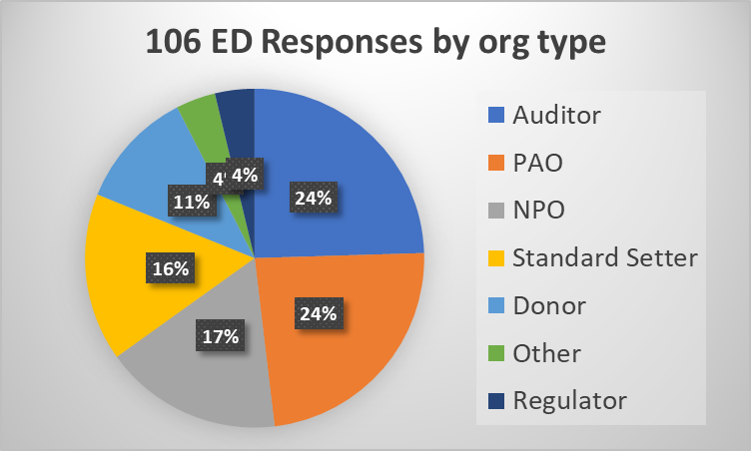
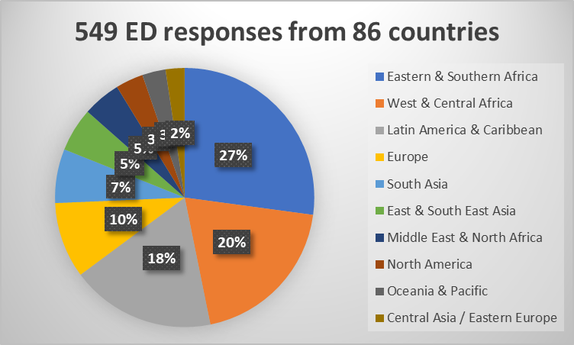
Exposure Draft responses
Geographic diversity
Stakeholder representation
Quantity & Quality
3 EDs 2022, 2023 & 2024
549 responses
179 written comment letters (106 organisations + 73 individuals)
370 surveys
Notes:
An ‘Exposure Draft’ is an early version of the text of an accounting standard, shared for public feedback as part of a structured consultation process with specific questions for respondents to answer.
The Exposure Draft of INPAS was published in 3 parts in 2022, 2023 and 2024 and received robust responses.
The quantity and diversity was impressive – with 549 responses from a range of stakeholders in 86 countries.
The depth and quality was also noteworthy. Many respondents had engaged with the explainer videos and webinar events and consequently made informed and helpful comments.
There was strong support for a majority of proposals, and also useful input that resulted in changes being reflected before the final standard was published.

Slide 23

INPAS benefits - doing more with less
International Non-Profit Accounting Standard
For NPOs: Simplifies and standardises financial reporting, easier to measure and manage financial sustainability, comply with donor reporting requirements, attract quality funding.
For Funders: Confidence in the financial integrity of NPOs, facilitates informed funding decisions, streamlined accountability for grants.
For regulators: Strengthen civil society space and sector oversight
For Auditors: A clear, consistent framework for auditing financial statements, reducing ambiguity and increasing audit quality.
Notes:
INPAS is valuable because of the benefit it brings for all stakeholders
Due to both internal or external pressures, Non-Profit Organisations are constantly striving to do more with less – to achieve more impact with each dollar.
INPAS makes financial reporting easier and more effective, so that NPOs can raise funds and focus more efforts on their delivering their important missions.
There are benefits for ALL stakeholders
For NPOs: Standardisation of donor reporting formats saves time, and makes compliance easier. The changes to financial statement presentation and introduction of fund accounting make it easier for leaders to measure and manage financial sustainability. The credibility associated with meeting an international standard can also help NPOs to attract quality funding – including unrestricted funding and more fairer contribution to support costs.
For Funders: Clearer audit assurance helps build confidence about financial integrity. More relevant information in the financial statements and narrative report facilitates more informed decisions and smoother due diligence processes. And streamlined accountability for grants can result in quicker and more accurate grant reporting.
For Regultors: Civil Society and Non-Profits often provide essential complements to government efforts to meet the Sustainable Development Goals (SDGs). Appropriate sector oversight includes financial reporting, as highlighted in the Anti Money Laundering recommendations from the Financial Action Task Force.
For Auditors: Auditors play an vital role in building trust and confidence with external stakeholders. INPAS provides a clear, consistent framework to audit against, reducing ambiguity and increasing audit quality.

Slide 24
Exploring INPAS and its adoption
Notes:
We will taker closer look at what is in INPAS, and how it gets adopted.

Slide 25
INPAS Structure
INPAS sections grouped by
A Principles
B Financial statements
C Revenue
D Expenses and liabilities
E Non-financial assets
F Financial assets and liabilities
G Consolidation and reporting boundaries
H Restatements and additional information
Z Transition to INPAS
Notes:
The sections in the IFRS for SMEs Accounting Standard were re-structured into the following groups. The Annex to INPAS shows the mapping of the sections.
There are sections in each group – for example Section A2 Concepts and Pervasive Principles, or Section D3 Fundraising costs

Slide 26
What’s new - content
New NPO-specific content
NPOs
A1
Narrative reporting
A3
Fund accounting B8
Revenue (grants and donations)
C1
New terminology
Expenses
D1
Grants given
D2
Fundraising costs
D3
Control and the reporting entity
G1
Financial statements
Modifications
Supplementary information
H4
Notes:
There is some brand new content in INPAS – the kay areas are shown here.
Characteristics that describe which entities are NPOs (A1)
Narrative reporting requirements for all NPOs, and the principles to be followed (A3)
Fund accounting – identifying funds and when those funds are restricted, what can be charged to a fund, and disclosures (B8);
Recognition and measurement of revenue from grants and donations, including donations in kind, and permitted exceptions (C1);
Presentation and disclosures relating to of expenses - by nature, function or a mixture (D1)
Recognition and measurement of grants made to individuals and organisations (D2);
Definition and presentation of fundraising costs (D3);
Describing control (in the absence of shares) that would require combined or consolidated financial statements (G1), and
Information needed where NPOs use INPAS Practice Guide 1 – Harmonised grant reporting (H4)

Slide 27
What’s new - terminology
New NPO-specific content
The IFRS for SMEs Accounting Standard | INPAS
Profit or loss | Surplus or deficit
Subsidiary | Controlled entity
Parent | Controlling NPO
Investment | Beneficial interest
Equity (financial statement element) | Net assets
Equity (investor interest in an entity) | Equity claims
Cash-generating unit | Operating unit
Dividends | Distributions arising from equity claims
New terminology
Financial statements
Modifications
Notes:
Some terminology has been replaced to make sure the words used are relevant for the sector.
Profit or loss has been replaced with surplus or deficit – which doesn’t carry the same association with financial performance. Surpluses or deficits in a particular year could ben driven simply by timing differences between income and expenditure, rather than excellent or poor financial performance.
Subsidiary and parent are replaced by controlled entity and controlling NPO, recognising that control of an NPO by another entity usually arises through mechanisms other than shareholdings.
‘Equity‘ means two distinct things in English. Firstly it’s the financial statement element, that is the credits on the balance sheet that are not liabilities. In INPAS this is called net assets, because it is equal in value to assets minus liabilities.
The other meaning of equity is when an investor has an interest, say shares, that give it a right to a share of the net assets upon dissolution. This type of equity is expected to be rare, but we were made aware of examples, eg where founders have to provide a nominal amount of equity in order to establish the entity.This is called ‘equity claims’ in INPAS.
IFRS for SMEs Accounting Standard, includes the term ‘cash generating unit’, particularly with reference to asset impairment. Since in INPAS, assets may have value because of their service potential rather than cash generating potential, this has been renamed simply ‘operating unit’.
Finally, in the rare cases where distributions are made to the holders of equity claims, the term dividends is not used.

Slide 28
What’s new – financial statements
New NPO-specific content
INPAS | The IFRS for SMEs Accounting Standard
Statement of Financial Position | Statement of Financial Position
Statement of Income and Expenses | Single statement of comprehensive income or separate income statement and statement of comprehensive income
Statement of Changes in Net Assets
 | Statement of Changes in Equity
Statement of Cash Flows | Statement of Cash Flows
New terminology
Financial statements
Modifications
Notes:
There are some changes to the names of the primary financial statements
The statement of financial position, or balance sheet, is unchanged, as is the statement of cashflows.
The Income Statement has been renamed the Statement of Income and Expenses. INPAS does not allow the option for a single statement of comprehensive income.
The Statement of Changes in Net Assets is a requirement and is renamed from the Statement of changes in Equity.

Slide 29
Modifications (highlights)
New NPO-specific content
Presentation of exchange gains and losses (A5)
Disclosure of employee expenses (D4)
Measure for inventory held for distribution at no or nominal consideration (E1)
Deemed cost of donated non-financial assets (E2-E4)
Transaction disclosure for governing body members (H1)
New terminology
Financial statements
Modifications
Notes:
Without going into much detail, this slide gives the highlights of some of the modifications that have been made to address NPO specific issues.
For example:
The presentation of exchange gains and losses is impacted by fund accounting.
NPOs often carry inventory, eg medical supplies, to be used or distributed, rather than sold. So there is guidance about how to value them.
When NPOs receive donations of fixed assets, there is guidance about how to estimate the deemed cost.
There are some additional disclosure requirements relating to expenses reimbursement for governing body members

Slide 30
INPAS Adoption
  INPAS is available and ready to use now
  NPOs – check with auditors to see if voluntary adoption is permitted
  Regulators / standard setters / trainers – please apply for a free licence
  www.inprf.org/adopting-inpas/ for more information and resources
Notes:
We have seen what is INPAS, and the benefits of adopting it.
INPAS is available for free download and use with immediate effect
NPOs – may wish to check with their auditors if voluntary adoption is permitted in your jurisdiction
Regulators / national standard setters – if you are interested in allowing or requiring adoption of INPAS by NPOs in your jurisdiction, please apply for a licence.
Visit the website https://www.inprf.org/adopting-inpas/ for more information and resources

Slide 31
Links for more information
About INPAS video
INPRF.org website (including newsletter sign up)
Download INPAS
Download INPAS Practice Guide 1: Harmonised Grant Reporting
FAQ
YouTube and LinkedIn
Get involved (includes links for Communities of Practice)
Get in touch
Notes:
Here are some useful links for further information.
You can view the video, visit the website, download the standard, read the FAQ, follow us on social media, find other ways to get involved, such as joining a community of practice, or get in touch with the team directly.
Thank you!

