Slide 1

Improving the quality of non-profit financial reports while reducing the burden of multiple grant reporting formats
INPAS Practice Guide 1: Harmonised Grant Reporting
Notes:
These slides provide an overview of INPAS Practice Guide 1 : Harmonised Grant Reporting.
Before October 2025, there was no internationally recognised framework for NPOs (Non-Profit Organisations) to prepare their annual financial statements.
That was until publication of the International Non-Profit Accounting Standard (INPAS for short).

Slide 2
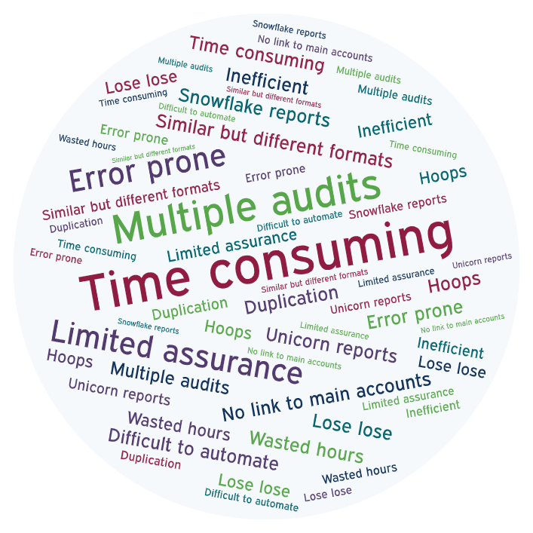
Problems with donor reporting
Grantors
  Risky
  error prone, easy to manipulate, difficult to audit
  late reports
Grantees
  Burdensome
  multiple formats and audits
  wasted hours, difficult to automate
Notes:
Donors have a right to accountability for grants, so many filled this gap with bespoke reporting requirements. Unfortunately, the lack of consistency has created a deeply problematic financial reporting ecosystem, with NPOs – who are the least resourced to bear the burden – left to struggle with the consequences. And even many grantors are not happy with the situation as it stands.

Slide 3
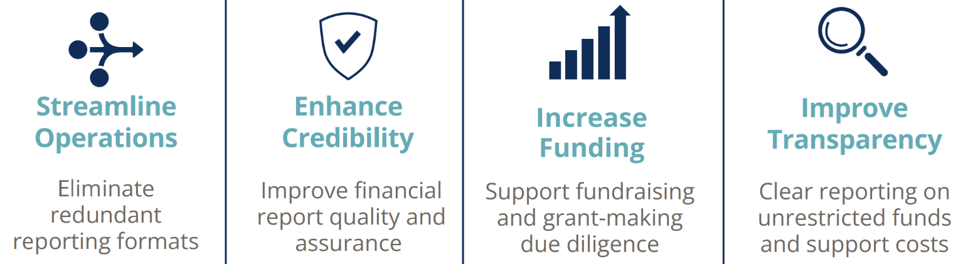
Doing more with less
The world’s first internationally applicable financial reporting standard designed for non-profits, by non-profits
Notes:
INPAS is designed to support non-profit organisations (NPOs), who are constantly under pressure to achieve more social impact for less money. By reducing the complex and often contradictory array of financial reporting requirements, finance operations can be streamlined, releasing more resource to frontline missional work.
92% of countries do not have a comprehensive national framework for non-profit accounting. Adherence to an international standard puts local non-profits from all over the world on an equal footing, reducing the equity gap, and building trust.
With more due diligence questions addressed in the audited accounts, this can reduce barriers to accessing funding.
Improved transparency about the use of unrestricted funds and support costs can build donor confidence to provide more flexible funding, greatly impacting on the sustainability of NPOs and the services they provide.

Slide 4
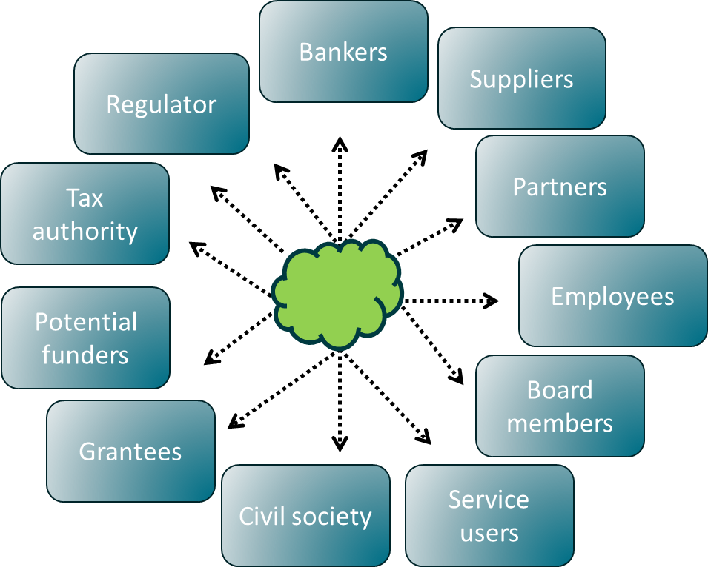
Current situation
Whole-of-entity reports
Grant reports
Funder 1
Funder 2
Funder 3
Notes:
This is a diagrammatic representation of the pre-INPAS reporting environment.
The dotted line on the left shows that general-purpose financial reports (represented by the nebulous cloud shape) have been of limited usefulness to most stakeholders.
On the right hand side, we can see different ‘snowflake’ formats for each donor – these are called special purpose financial reports. They meet the needs of one user only.
The black line in the centre represents that fact that there is often no easily auditable link between them, even though they should ideally come from same accounting system

Slide 5
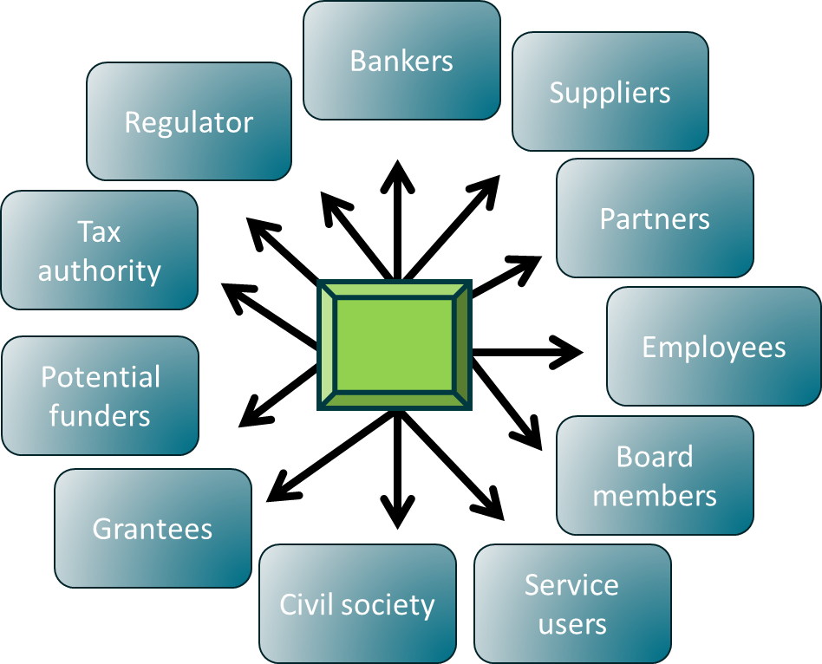

With INPAS
Useful reports
Harmonised grant reports
Funder 1
Funder 2
Funder 3
Notes:
Notice the different with INPAS.
General-purpose financial reports are useful to range of stakeholders (power shift and impact!)
Single format for donor reporting (reduced burden on NPOs)
Bridge / link between them (increased assurance for Funders)

Slide 6


INPAS and INPAS Practice Guide 1
~ 300 pages
whole-of-entity financial statements
Principles-based, accrual-basis accounting standard to provide ‘true and fair view’
Standard and Application Guidance
Individual grant reports link to whole-of-entity finances
~ 30 pages
grant reports
Rules-based guidance, pragmatic decision to harmonise
Practice Guide 1
Harmonised Grant Reporting
Notes:
INPAS and INPAS Practice Guide 1 work together, so that the whole-of-entity financial statements and grant reports can work together,
Information in the whole of entity accounts provides a link to the grant reports, and each grant report must include a reconciliation to the whole of entity accounts. This means a significant improvement in the reliability of grant reports. So it’s a win for NPOs AND funders!
One important distinction between INPAS and Practice Guide 1 is that INPAS is principles-based, while Practice Guide 1 is rules based. The headings in the harmonised grant report are unlikely to be the best headings for any one single grant, but the benefits to the sector of a single format are worth that cost.

Slide 7
Adopting INPAS and PG1
INPAS
International Non-Profit Accounting Standard
Practice Guide 1
Harmonised Grant Reporting
All NPOs
Greatest benefits when used together
May be used separately
Adoption driven Governments
Adoption driven by grant makers
Notes:
INPAS and PG1 are deigned to be used together, and this brings the greatest benefits.
But either can be used without the other.
Compliance with INPAS does not require use of PG1.
The use of INPAS is driven by countries – national standard setters and regulators
The use of PG1 is driven by grant makers.

Slide 8




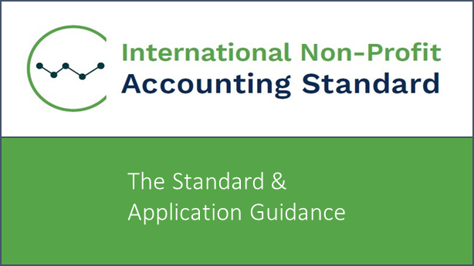
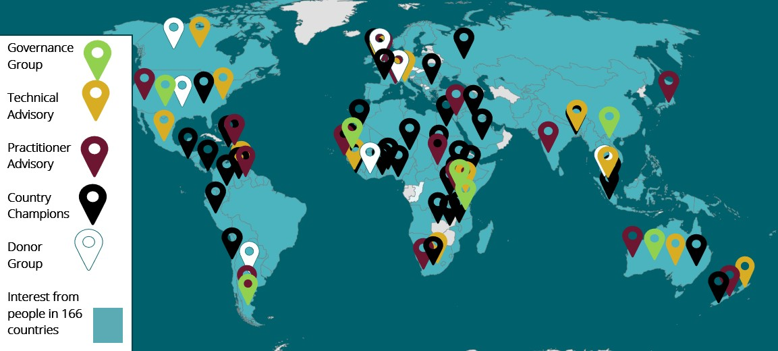
From Project to Legacy
Project partners
Founder members
2019-2025
2025 onwards
The Standard
The Community
15,000+
Newsletter subscribers
+ LinkedIn & YouTube
Notes:
INPAS was developed by the IFR4NPO Project over 6 years, within input from hundreds of stakeholders all over the world.
Practice Guide 1 was developed with input from a Donor Reference Group which included donors such as USAID (pre Jan 2025), FCDO, Global Affairs Canada, The World Bank, The Global Fund, The Ford Foundation, The Gates Foundation, and the Oak Foundation.
The main outputs from the project were the standard itself, (including Practice Guide 1) and the community of 15,000 followers in nearly 170 countries
These were handed over to a newly created entity, the International Non Profit Reporting Foundation, which is now the world’s third international accounting standard setting body (the other two are IFRS Foundation for for-profits and IPSASB for Governments).
Humentum and CIPFA partnered to deliver the IFR4NPO project, symbolising a long overdue collaboration between the nonprofit sector and the accounting profession. They continue to show their support as founding members of the new foundation, with more members expected to join in due course.
This ensures sustainability, with a body dedicated to promoting and supporting adoption and well as ensuring the standard remains relevant over time.

Slide 9

How to handle the complexity?
How to handle the complexity?
Notes:
While developing a harmonised grant reporting format, one challenge was how to accommodate the diversity, variability and complexity of grant budgets and expenditure headings. How could it be flattened without losing the necessary richness?

Slide 10
Budget analysis by inputs vs outputs
Complex / variable
Outputs
Simple / standardised
Inputs
Activities | $’000
Direct costs
Sponsorship programme | 20
Vaccination | 20
Tree planting | 15
Research | 15
Cash grants | 5
Education | 5
Women’s shelter | 5
Indirect costs | 25
TOTAL | 100
Cost types | $’000
Direct costs
Employment | 35
Travel | 5
Supplies & materials (goods) | 5
External services | 5
Assets / equipment | 5
Grants and donations | 5
Other direct costs | 3
Support costs | 25
TOTAL | 100
Notes:
The solution lay in focusing on inputs rather than outputs.
Imagine a project budget for $100k, split between $75k of direct costs and $25k indirect costs.
The direct cost headings represent different outputs, or activities, or impact areas. There could be an entire budget only for tree planting, but broken down into component aspects or phases of the work.
The indirect costs are a contribution to the NPO-wide costs that are necessary for the organisation to exist to that it can deliver various projects or programmes.
There is no way to harmonise around output or activity based cost headings – they vary for each grant, organisation, and over time.
But imagine the exact same budget with the exact same costs, restated and organised by the cost inputs, rather than the activities or outputs. It’s the same total $100, split between support costs of $25k and direct costs of $75k, but the direct costs are analysed by what the money is spent on rather than what it will achieve.
A staff member might spend time on a women’s shelter or education work, but the cost is still salaries.
A vehicle might move around to support cash granting work or vaccination programme, but the cost is still travel.
So by analysing costs by input, it becomes possible to achieve harmonisation. Many funders have headings that are similar to those shown above.

Slide 11
Activity based budgeting?
Best practice - separate coding and reporting
Prepare
Prepare direct budget using an activity-based budgeting worksheet
Under each output / activity heading, include a row for each resource / input
Restate
Summarise the same budget total, according to inputs (harmonized INPAS headings)
Add support costs associated with project delivery
Inputs
Use input basis for chart of accounts, primary expenses tracking and analysis
Report
Use activity basis for additional disclosures and tracking progress against targets.
Also for harmonised grant report & audit assurance
Notes:
This does not mean that activity-based budgeting and reporting is no longer recommended or required.
But it highlights the importance of keeping separate coding structures for input-based (or natural) expense classification vs output-based (or functional) expense classification. A harmonised set of input-based expense lines can be consistently and efficiently mapped from a grantee’s chart of accounts.
Any activity-based budget worksheet can be restated, with the exact same costs, and summarized according to a harmonised list of input headings.
Additional reporting by activity may be necessary for project managers and / or donors, but this would be done using a different set of codes.

Slide 12
INPAS Practice Guide 1 - format
Statement for activity X | Note | NPO Currency
Income
Grants and donations | 1
Other income (by type) | 2
Total income |  | 100,000
Expenses
Direct expenses
Employment | 3
Travel and subsistence | 4
Supplies and materials | 5
External services and other direct costs | 6
Services in-kind and gifts in-kind | 7
Grants and donations to others | 8
Support costs | 9
Total expenses |  | 80,000
Consistent with financial statements
Currency
Financial period
Accounting policies
Recognition (timing)
Consistent with INPAS
Measurement (amount)
Notes:
This slide and the ones that follow show what the format actually looks like.
The title of each Supplementary Statement needs to specify the activities included in the report. This report relates to a sub-set of the transactions of the organisation as a whole and it needs to be clear which transactions are included. It could be a specific grant, project, campaign or programme for example.
The lines for different types of income and expense are fixed, they cannot be changed or added to. The Practice Guide includes details of which costs to include under each heading. Line items with zero value can be omitted.
Splitting between direct costs and support costs is not mandatory.
Each row has notes for more information. Some notes are required by PG1, others may be only if a donor requires it.
For example, if a donor required information about consultants, the grant agreement could specify that note 6 should include that information.
There are 3 fixed parameters that are essential for reconciliation to the main accounts
1. Same currency as the NPO
2. Same financial period as the NPO’s annual audited accounts
3. Same accounting policies and basis as the NPO’s annual accounts
Reconciliation between a PG1-format grant report and the whole-of-entity accounts can be achieved, even if an the NPO is using a reporting framework other than INPAS (eg UK Charities SORP), as long as the NPO is tracking income, expenses and balances according to different funds.
If the NPO’s annual accounts are on an accrual basis, but the donor prefers reports on a cash basis, there is a standard format note to reconcile income and expenses according to the associated cash-basis figures.
In the example shown here, you can see income of 100,000 and expenses of 80,000. Note that there is no expense line for assets or equipment. We will come back to that!

Slide 13
PG1 format continued
Statement for activity X (continued) | Note | NPO Currency
Foreign currency translation gains/losses |  | -
Transfers |  | -
Other financial movements |  | -
Change in grant [fund] balance |  | 20,000
Opening balance |  | -
Closing balance |  | 20,000
100k income, less 80k income
Notes:
This is a continuation of the format.
Underneath expenses we have rows for foreign currency gains or losses, transfers between funds and any other financial movements.
This comes to a line for the net change, and finally the opening balance and the closing balance.

Slide 14
Connection to main accounts
Movement in funds note
 | Opening balance | Income | Expenses | Transfers between funds | Closing Balance
Restricted funds
Grant fund | - | 100,000 | (80,000) | - | 20,000
Unrestricted funds
TOTAL
Notes:
One of the ways in which this links to the main accounts is via a mandatory note in the whole-of-entity financial statements, called a ‘Movement in Funds Note’
It splits out various restricted and unrestricted funds down the side, and along the top it shows the opening balance, income, expenses, transfers and closing balance.
The total fund balances would agree to the figures shown on the face of the balance sheet (Statement of Financial Position), while the total income and expenses would agree to the figures on the Statement of Income and Expenses. This is a powerful way to see how one particular grant (shown as one row) fits into the organisation as a whole.

Slide 15

Grant funded assets
The problem
Donors sometimes give cash for assets (eg vehicles, equipment etc)
Most donors want to see accountability for the asset purchase (on a cash basis)
Accrual accounting requires assets to be capitalised and depreciated over their useful lives
Under double entry accounting rules you can’t double debit – ie charge the asset purchase as an expense AND also capitalise it.
INPAS requires that restricted use assets remain within restricted funds
Notes:
Grant funded assets can be a problem for the reasons shown
2 possible solutions are consistent with INPAS

Slide 16
Grant funded assets – solution 1
Statement for activity X (continued) | Note | NPO Currency
Foreign currency translation gains/losses |  | -
Transfers |  | -
Other financial movements |  | -
Change in grant [fund] balance |  | 20,000
Opening balance |  | -
Closing balance |  | 20,000
Capital & Inventory Costs
Total expenses (as above) |  | 80,000
Plus: capital costs incurred |  | 20,000
Less: depreciation / amortisation charged above |  | -
Expenses, inventory and capital costs |  | 100,000
Opening balance including inventory and capital costs |  | -
Closing balance including inventory and capital costs |  | -
From earlier slide
Closing balance
Closing balance
20,000
less
capital costs
20,000
Optional
Notes:
Solution 1 is an additional optional section added to the bottom of the grant report. Starting with the 80,000 total expenditure, any depreciation charged within that figure is removed (to avoid double counting), and then the amount of capital costs incurred (assets purchased) in the year is added, with revised opening and closing balances that are more easily reconcilable to the donor’s own records.
Separate rows for inventory can also be added where relevant – taking out inventory issued, and adding inventory purchased.

Slide 17
Grant funded assets – solution 2
Statement for activity X (continued) | Note | NPO Currency
Foreign currency translation gains/losses |  | -
Transfers | X | (20,000)
Other financial movements |  | -
Change in grant [fund] balance |  | -
Opening balance |  | -
Closing balance |  | -
Note X explains this is asset purchase
100k income, less 80k income, less 20k transfer
Notes:
As second option is to use the transfers line, with an explanation in the note.

Slide 18
Grant funded assets – solution 2
Movement in funds note
 | Opening balance | Income | Expenditure | Transfers between funds | Closing Balance
Restricted funds
Grant fund | - | 100,000 | (80,000) | (20,000) | -
Asset fund |  |  |  | 20,000 | 20,000
Unrestricted funds
TOTAL
Notes:
If Solution 2 is used, the other side of the transfer could be to a separate asset fund – particularly if there were use restrictions on that asset, or to unrestricted funds. This way the asset remains on the balance sheet, and is removed from the grant fund without being expensed.

Slide 19

Accommodating donor needs
Fixed
Expenditure headings
Financial year
Currency
Period
Flexible
Additional analysis or info in notes
Additional column headings
Millenium Bridge, London
Notes:
They key benefit of INPA Practice Guide 1 is in achieving the delicate balance between have enough fixed elements to achieve the consistency and burden reduction, while retaining sufficient flexibility to accommodate different donor needs.
London’s Millenium bridge wobbles a significant amount to accommodate wind and footfall, and yet retains its structural integrity.
Same with INPAS PG1, it can be stretched and pulled in different ways to accommodate donor needs, without losing the key benefits of harmonisation.
The next 3 slides show a variety of column heading options that enable this.

Slide 20
Column options - donor
Statement for activity X | Note | NPO currency | Donor currency | Donor budget
Income |  | 100,000
Expenses |  | 80,000
Change in grant [fund] balance |  | 20,000
Opening balance |  | -
Closing balance |  | 20,000
Notes:
Without changing the core format and requirements for reporting historical actuals in NPO currency for the period, there is flexibility for funders in terms of choosing which other columns they would like to see. In this example we see the donor currency and budget.

Slide 21
Column options - periods
Statement for activity X | Note | Month 1-6 | Months 7-12 | NPO currency
Income |  |  |  | 100,000
Expenses |  |  |  | 80,000
Change in grant [fund] balance |  |  |  | 20,000
Opening balance |  |  |  | -
Closing balance |  |  |  | 20,000
Notes:
In this example the financial year is split into different periods. If a grant period straddles different financial years, figures from a previous financial year could be added in.

Slide 22
Column options – funding source
Statement for activity X | Note | Source 1 | Source 2 | NPO currency
Income |  |  |  | 100,000
Expenses |  |  |  | 80,000
Change in grant [fund] balance |  |  |  | 20,000
Opening balance |  |  |  | -
Closing balance |  |  |  | 20,000
Notes:
Columns for different funding sources can be useful for jointly funded programmes, cost sharing contributions, showing revenue raised or costs incurred that relate to a project or activity (according to the specified title) but are not covered by the funding (eg FX losses, support costs or ineligible costs).
Donors decide or agree with their grantees which specific column headings or analysis is most relevant and useful in the situation. For example, there could be a primary split by period, and then in the notes the figures for a certain period are converted to donor currency and compared to the budget.

Slide 23
Inclusion with NPO Main Accounts
Clearly separated
Annex?
Audit status
Notes:
There is an option, at the discretion of an NPO and its funder(s) to include grant reports as Supplementary Statements annexed to the main accounts. If this is done, the audit status of any such annexes must be very clear.

Slide 24
Links
About INPAS video
INPRF.org website (including newsletter sign up)
Download INPAS
Download INPAS Practice Guide 1: Harmonised Grant Reporting
FAQ
YouTube and LinkedIn
Express interest in Donor Community of Practice
Get in touch
Notes:
Here are some useful links for further information.
You can view the video, visit the website, download the standard, read the FAQ, follow us on social media, find other ways to get involved, such as joining a community of practice, or get in touch with the team directly.

